Slide 1
When your organisation runs out of ideas Knowledge Fund will help your
Enterprise Knowledge Economy grow
Max Barrass
Founder & CEO
E: max.barrass@governance.foundation
L: linkedin.com/in/MaxBarrass
M: 0410 533 731

Slide 2
Our Experiences
Knowledge Fog - help organisation understand what knowledge is yet to be explored
Knowledge Architect - help to build knowledge landscape
Knowledge Diagram - generate diagrams
Knowledge Artifacts - generate artifacts
Knowledge Finder - assistant to find knowledge
Knowledge Experience - generate new personalised interactive experiences
Knowledge Assistant - help employees with admin tasks
Knowledge Rewards - generate rewards for knowledge
Knowledge Socials - help to keep social relationships at work, everyone's personal crm
Knowledge Operations - help to drive implementation and maintenance
Notes:
Primary focus, disrupt enterprise workforce experience platforms.
Develop experiences that do not waste enterprise time, by eliminating old school ways of working. Typewriters have disappeared so should those ways of working. Focus on data and let data present it self in all the ways relevant.
Don’t waste human invaluable time, let people do what they are good at innovate, let computers do the rest.
People are not librarians, let computers sort it out.
People are not babysitters, let computers do that.
People are not assistants, let computers do that.

Slide 3
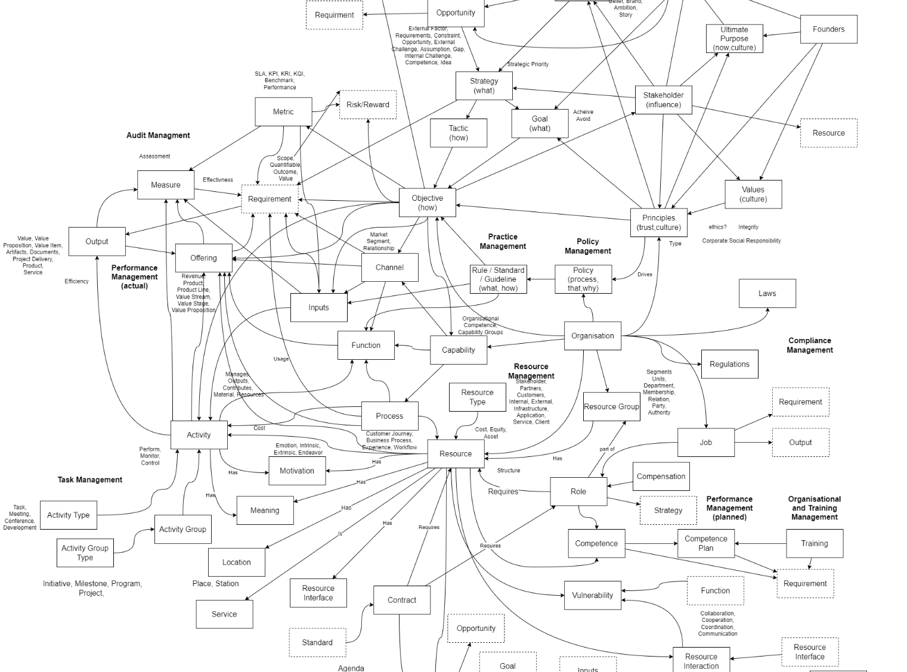
Knowledge Fog
At a glance show organisational focus
Insight to next best action
Provide heatmap of knowledge freshness
Determine maturity awareness
Notes:
Levels
“known knows” - knowledge kept up to date recently
"known unknowns" - knowledge that is stale, need you to work in that space to refresh our common understanding
“unknown unknown” - knowledge that does not exist or is too long since it has been accessed, things that have not been explored but they are there
This allows organisation to understand focus of the organisations

Slide 4
Knowledge Architect
Extend and drive knowledge architecture and exploration

Slide 5
Knowledge Diagram
Generate diagrams from existing knowledge

Slide 6
Knowledge Artifacts

Slide 7
Knowledge Finder

Slide 8
Knowledge Experiences

Slide 9
Knowledge Assistant
Enable contribution
Drive participation
Help with mundane
Help with organiston
Pay attention to employee

Slide 10
Knowledge Rewards
Provide participation incentives

Slide 11
Knowledge Socials
Integrate internal knowledge with external influence

